Slide 1
HTML5
Chapter 3-Extended

Slide 2

WHAT IS HTML5 ?
Newest draft version of HTML/XHTML
Supported by modern browsers
  Safari, Google Chrome, Firefox, Internet Explorer 9
Intended to be backwards compatible
Adds new elements
Adds new functionality
  Edit form data
  Native video and audio
  And more!
Source: W3C http://www.w3.org/html/logo/

Slide 3
NEW FEATURES
Some of the most interesting new features in HTML5 are:
  The <canvas> element for 2D drawing
  The <video> and <audio> elements for media playback
  Support for local storage
  New content-specific elements, like <article>, <footer>, <header>, <nav>, <section>
  New form controls, like calendar, date, time, email, url, search

Slide 4
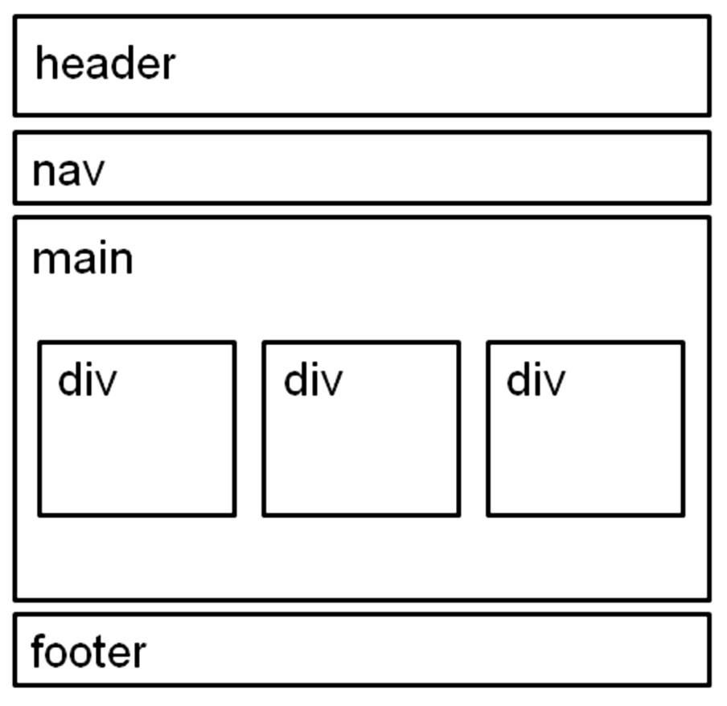
HTML5 STRUCTURAL ELEMENTS
header Element
  <header></header>
  Contains the web page
  document’s headings
nav Element
  <nav></nav>
  Contains web page
  document’s main navigation
main Element
<main></main>
Contains the web page
document’s main content
footer Element
  <footer></footer>
  Contains the web page
  document’s footer

Slide 5
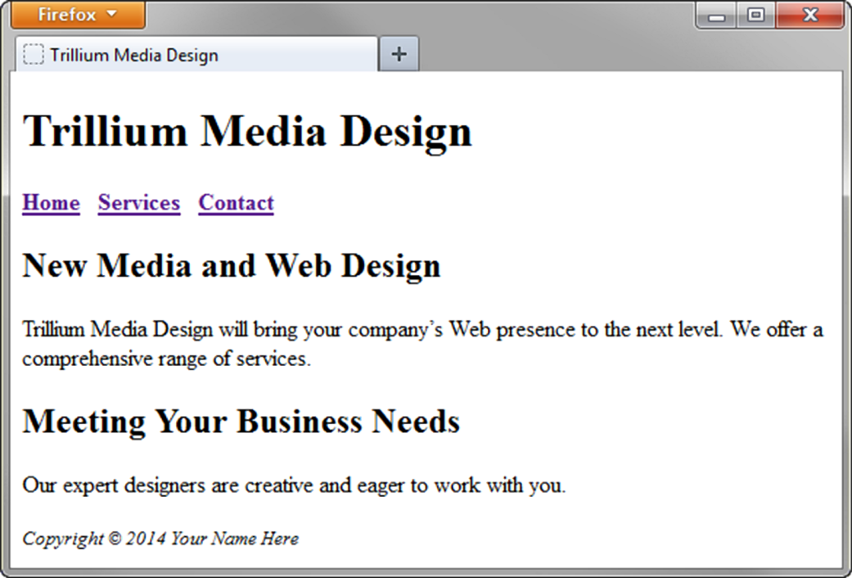
HTML5 STRUCTURAL ELEMENTS
<body>
<header> document headings go here </header>
<nav> main navigation goes here </nav>
<main> main content goes here </main>
<footer> document footer information goes here </footer>
</body>

Slide 6
NEW HTML 5 ELEEMENTS
ELEMENTS | DESCRIPTION
<article> | Represent a self contained composition in a page, like a blog post, user forum post, or newspaper article.
<aside> | Contains content that is supplemented to the page content, like a callout or sidebar.
<section> | A thematic grouping of content, typically with a header and possibly of footer.
<time> | can contain a date or time or both.
<video> | Used to add video media to your page.

Slide 7
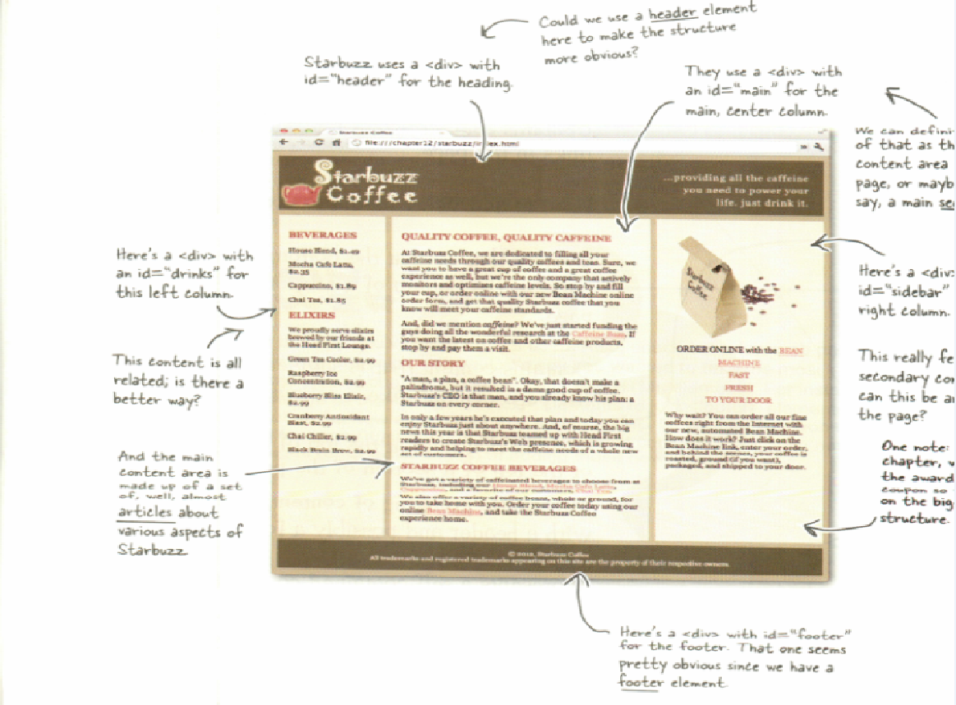

Slide 8
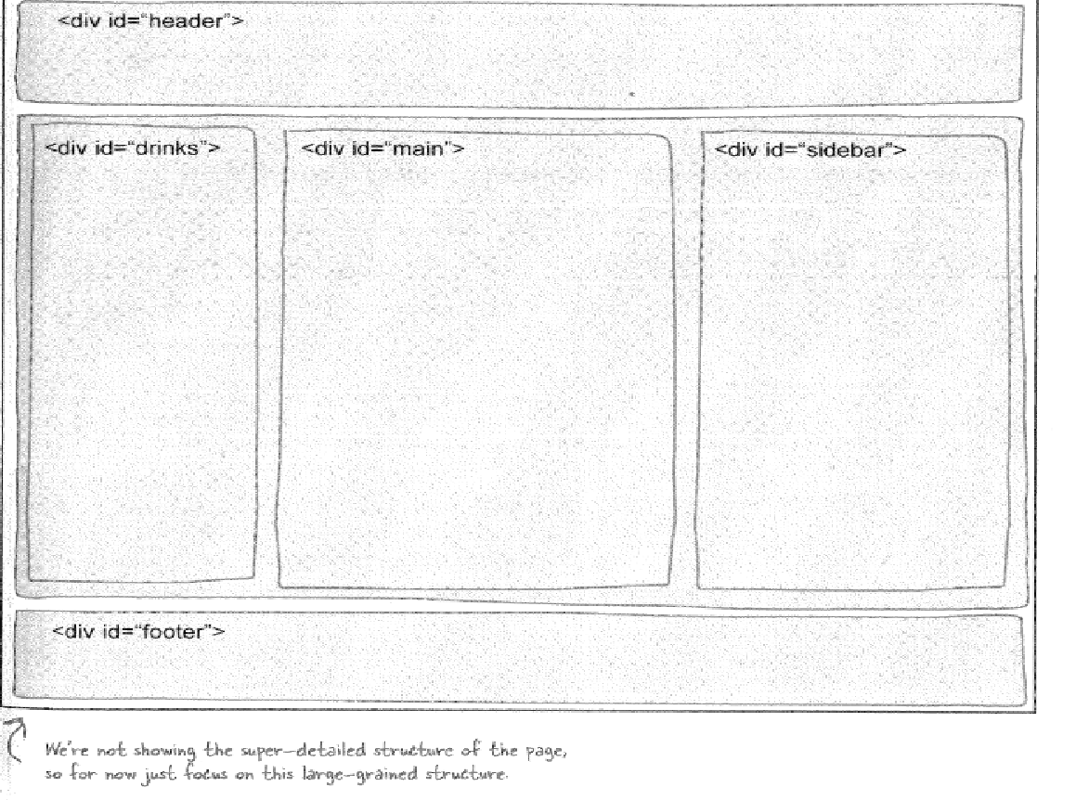

Slide 9
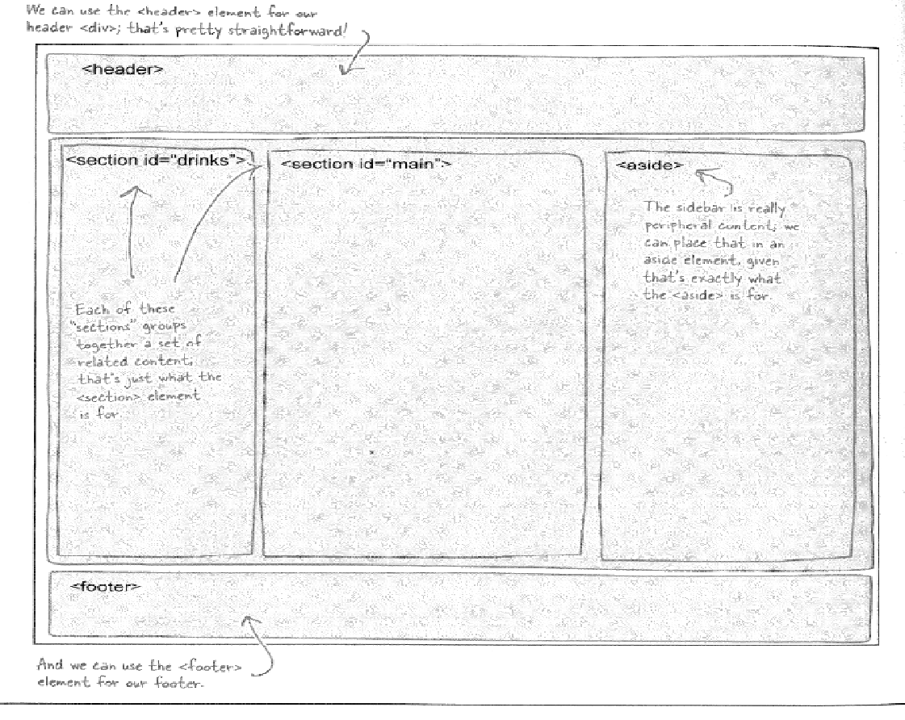

Slide 10
FORMS & FORMS CONTROL
Form – gather information from a web page visitor.
Forms control – the objects that accept the information.
  text boxes
  scrolling text boxes
  select lists
  radio buttons
  check boxes
  Buttons
HTML 5 – new form controls
  e-mail address
  URLS
  dates & date selections
  times
  numbers

Slide 11
FORM ELEMENT
Attribute | Value | Purpose
action | URL /file name/file path of server-side processing script | Required: Indicates where to send the form information when the form is submitted
method | get post | Default value get – the form data to be appended to the URL and sent to the web server post – more private & transmits the form data in the body of the HTTP response more preferred by the W3C
id | Alphanumeric, no spaces, unique & not used for id values on the same web page document. | Optional Provides a unique identifier for the form.
name | Alphanumeric, no spaces, begin with a letter; choose a form name value that is descriptive but short (Order Form is better than Form1) | Optional The form can be easily accessed by cliebt-side scripting languages, to edit and verify the form information before the server-side processing is invoked.

Slide 12
FORM ELEMENT
Why use both the “name” and “id” attributes on form controls?
“Name” – names the form element. So, it can be easily accessed by client-side scripting languages e.g JavaScript or by server-side processing languages such as PHP.
“id” – for use with CSS & scripting.
The values assigned to the “name” & “id” attributes on a particular form element are the same

Slide 13
HTML5: EMAIL TEXT BOX
<input>
Accepts text information in e-mail address format
Attribute | Value | Purpose
type | Text | Configures a text box
name | Alphanumeric, no spaces, begin with a letter | Names the form element – unique. It can be easily accessed by client-side scripting languages or server-side processing.
id | Alphanumeric, no spaces, begin with a letter | Provides a unique identifier for the form element
size | Numeric value | Width of the text box
maxlength | Numeric value | The max. length of data accepted by the text box.
required | Required | HTML5 attribute; browser verifies entry of information before submitting the form.

Slide 14
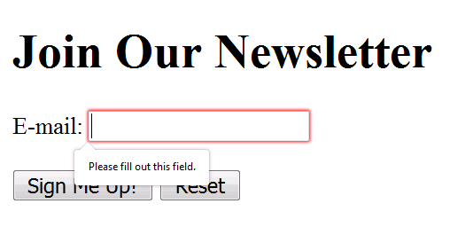
HTML5: EMAIL TEXT BOX
<!DOCTYPE html>
<html lang="en">
<head>
<title>Form Example</title>
<meta charset="utf-8">
</head>
<body>
<h1>Join Our Newsletter</h1>
<form method="get">
<label for="email">E-mail:</label>
<input type="email" name="email"
id="email“ required="required" >
<br>
<br>
<input type="submit" value="Sign Me Up!"> <input type="reset">
</form>
</body>
</html>

Slide 15
HTML5: URL TEXT BOX
<input>
Accepts text information in URL format
Common Attributes:
  type=“url”
  name
  id
  size
  maxlength
  value
  placeholder
  required

Slide 16
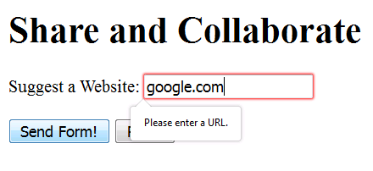
HTML5: URL TEXT BOX
<!DOCTYPE html>
<html lang="en">
<head>
<title>Form Example</title>
<meta charset="utf-8">
</head>
<body>
<h1>Share and Collaborate</h1>
<form method="get">
<label for="myWebsite">Suggest a Website:</label>
<input type="url" name="myWebsite" id="myWebsite" >
<br>
<br>
<input type="submit" value="Send Form!"> <input type="reset">
</form>
</body>
</html>

Slide 17
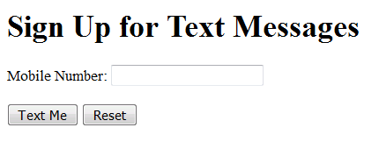
HTML5: TELEPHONE NUMBER TEXT BOX
<input>
Accepts text information in telephone number format
Common Attributes:
  type=“tel”
  name
  id
  size
  maxlength
  value
  placeholder
  required

Slide 18
HTML5: TELEPHONE NUMBER TEXT BOX
<!DOCTYPE html>
<html lang="en">
<head>
<title>Form Example</title>
<meta charset="utf-8">
</head>
<body>
<h1>Sign Up for Text Messages</h1>
<form method="get">
<label for="mobile">Mobile Number:</label>
<input type="tel" name="mobile" id="mobile" >
<br>
<br>
<input type="submit" value="Text Me"> <input type="reset">
</form>
</body>
</html>

Slide 19
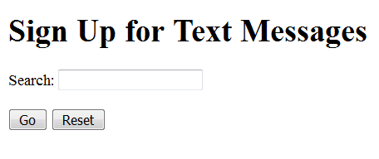
HTML5: SEARCH TEXT BOX
<input>
Accepts search terms
Common Attributes:
  type=“search”
  name
  id
  size
  maxlength
  value
  placeholder
  required

Slide 20
HTML5: SEARCH TEXT BOX
<!DOCTYPE html>
<html lang="en">
<head>
<title>Form Example</title>
<meta charset="utf-8">
</head>
<body>
<h1>Sign Up for Text Messages</h1>
<form method="get">
<label for="keyword">Search:</label>
<input type="search" name="keyword" id="keyword" >
<br>
<br>
<input type="submit" value="Go"> <input type="reset">
</form>
</body>
</html>

Slide 21
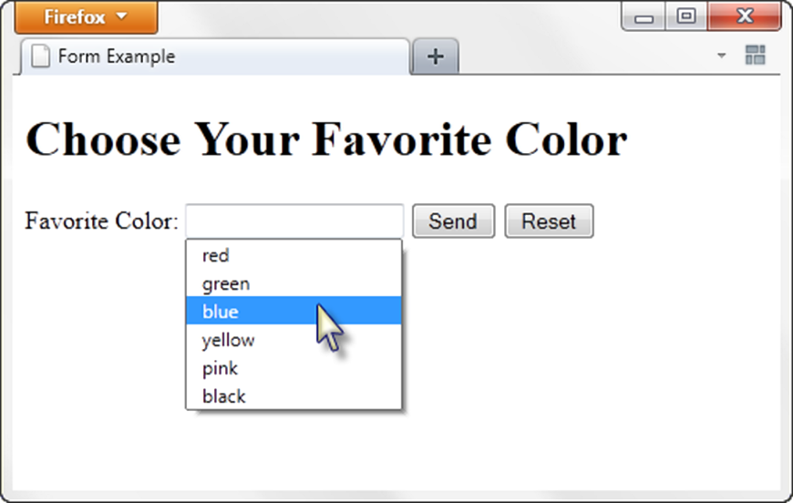
HTML5: DATALIST CONTROL
<label for="color">Favorite Color:</label>
<input type="text" name="color" id="color" list="colors" >
<datalist id="colors">
<option value="red">
<option value="green">
<option value="blue">
<option value="yellow">
<option value="pink">
<option value="black">
</datalist>

Slide 22
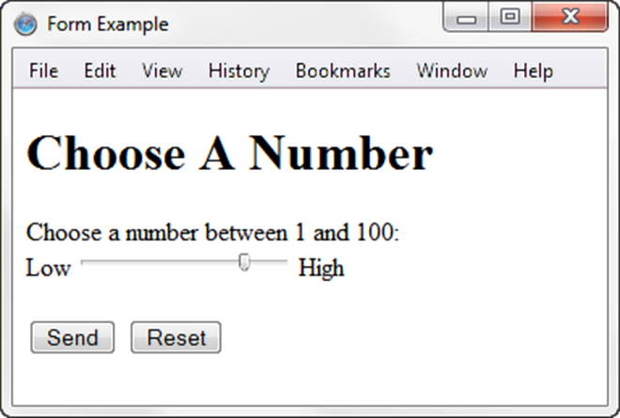
HTML5: SLIDER CONTROL
<label for="myChoice">
Choose a number between 1 and 100:</label><br>
Low <input type="range" name="myChoice" id="myChoice" min="1" max="100"> High

Slide 23
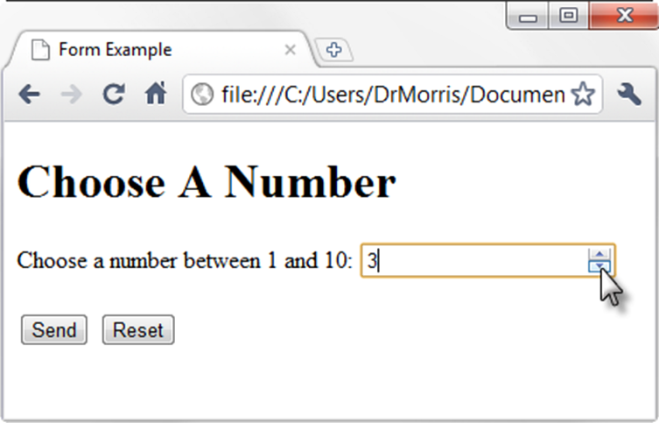
HTML5: SPINNER CONTROL
<label for="myChoice">Choose a number between 1 and 10:</label>
<input type="number" name="myChoice" id="myChoice"
min="1" max="10">

Slide 24
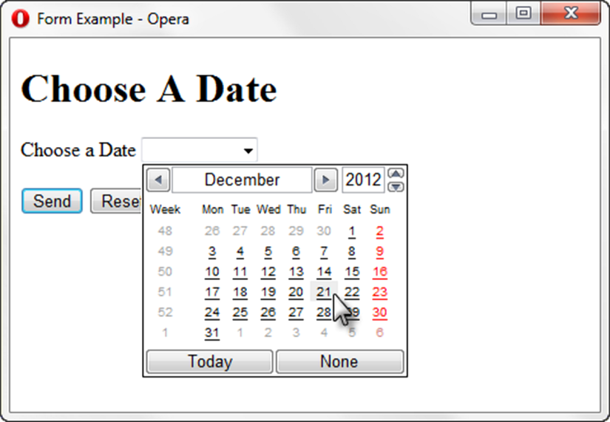
HTML5: CALENDAR CONTROL
<label for="myDate">Choose a Date</label>
<input type="date" name="myDate" id="myDate">

Slide 25
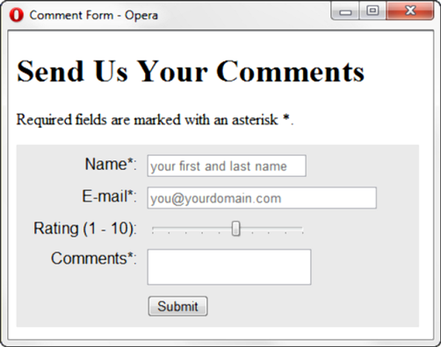
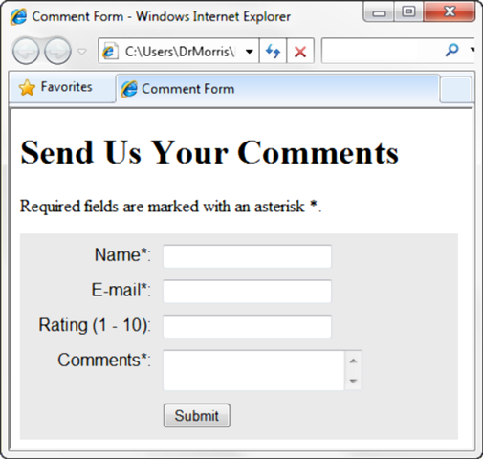
PRACTICE WITH AN HTML5 FORM
The form display and functioning varies with browser support.

